Slide 1
1. BERT Applications
Gerhard Binder

Slide 2
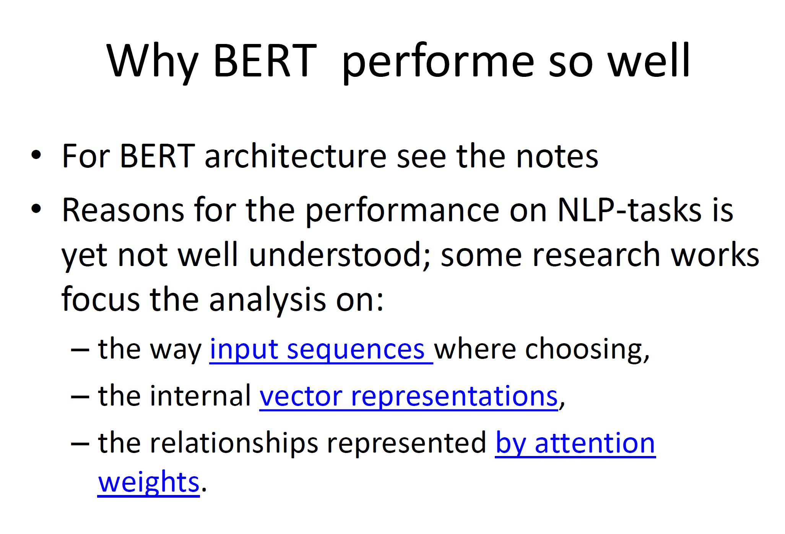

Slide 3
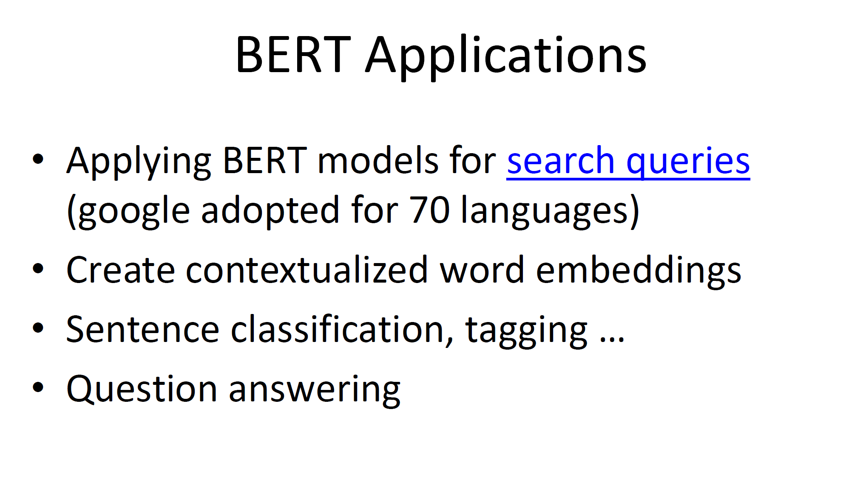

Slide 4
3. AdaNet: AutoML with Ensembles
Alessio Ciullo

Slide 5
Goal
Automate as many aspects as possible of a ML project
The user only drops in data and the system sets the rest (e.g. architecture, hyperparameters, etc.) as well as performing training and validation

Slide 6
Attempts
Google AutoML has been trying to do so using reinforcement learning and Recurrent Neural Networks (RNN) with the goal of optimizing the performance of the overall system
AdaNet: it uses reinforcement learning to build ensembles of the networks, i.e. it makes use of various network architectures

Slide 7
4. AutoAugment:
Deep RL Data Augmentation
Desilvestro Valentino

Slide 8
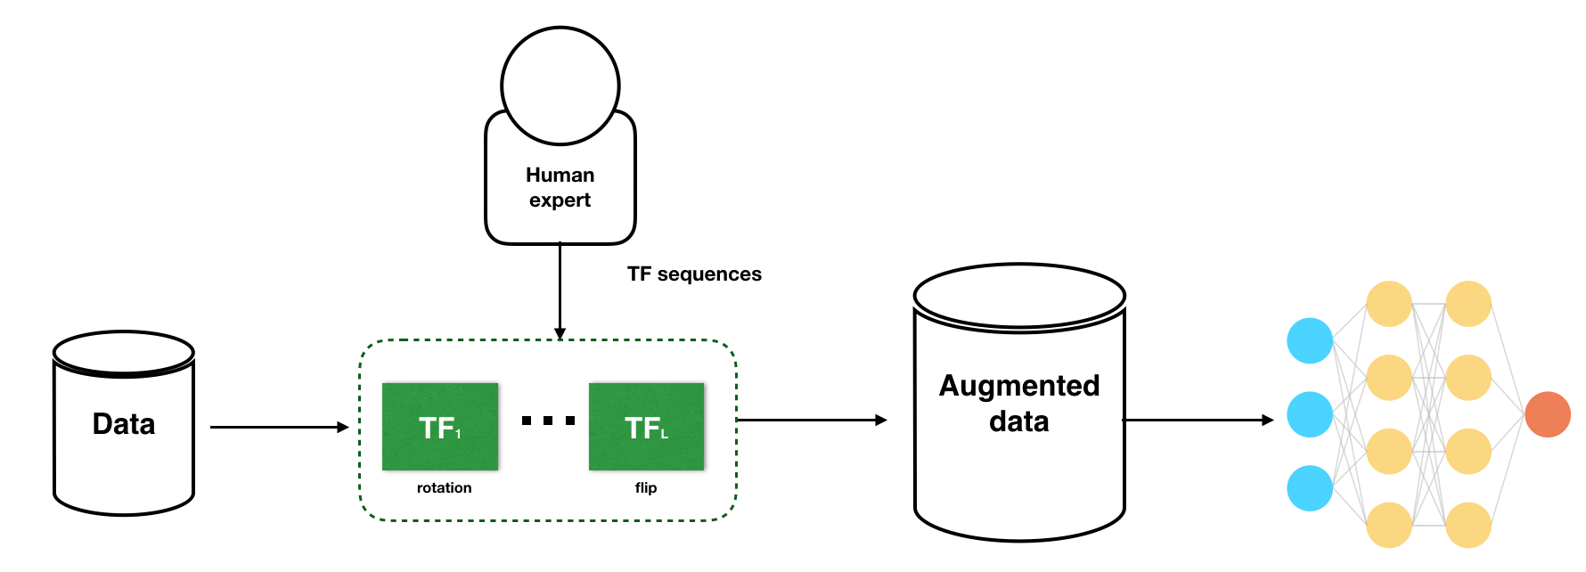
Why data augmentation?
Not enough labeled data: need to learn a lot from a little!
AutoAugment innovations:
Use RNN to find out which augmentation policies improve performance
Transfer learning: can apply optimal policies to new data/problems

Slide 9
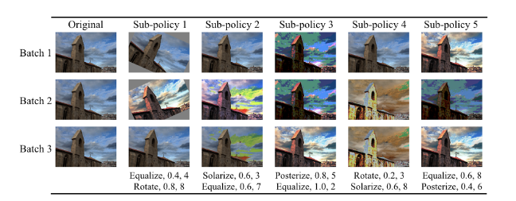
How does AutoAugment work?
Determine a search space, with one policy consisting of many sub-policies (2 image processing functions, each with 2 hyperpar (prob, magnitude))
For each image in each mini-batch, randomly select one policy
Algorithm (controller RNN) that selects best policies

Slide 10
Useful links:
https://arxiv.org/pdf/1805.09501.pdf
http://ai.stanford.edu/blog/data-augmentation/

Slide 11
5. Training Deep Networks with Synthetic Data
CAS AML Uni Bern
Michael Freunek

Slide 12
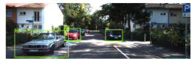
Goal: Object detection

Slide 13
Why training with („messed“) synthetic data?
Real data are „expensive“ (hard to collect)
Also: High-fidelity synthetic data are „expensive“ to generate
Training with (not so much) real data get poor results

Slide 14
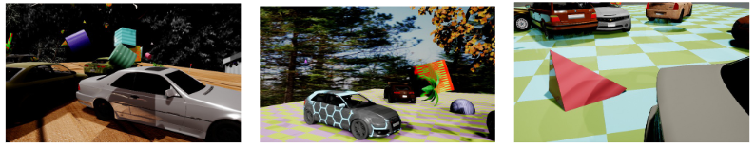
How are the (messed) synthetic data generated?
Domain randomization → lighting, pose, textures… of the environment is randomized to non-realistic values
Rotation, scaling, lighting etc. of the objects of interest
Flying distractors added to the scenes (flying cubes etc.)
Synthetic fine tuning/augmenting/modification of real data

Slide 15
Results / Benefits and Reference
Model learns „to focus“ on relevant features in complex environments → Outperformance of models trained only with real data
Cheaper way of creating trained models
Applicant: Nvidia
Reference: Training Deep Networks with Synthetic Data: Bridging the Reality Gap by Domain Randomization, Jonathan Tremblay, Aayush Prakash, David Acuna, Mark Brophy, Varun Jampani, Cem Anil, Thang To, Eric Cameracci, Shaad Boochoon, Stan Birchfield, 2018, eprint1804.06516, arXiv

Slide 16
6. Segmentation Annotation with Polygon-RNN++
Andres Anobile Perez

Slide 17
What does it do
Used as an aid tool for object segmentation in digital images
How does it do it
Uses RNN to suggest polygons to segment an object inside a boundary box.

Slide 18
Process workflow
Label the image
Draw a boundary box
RNN++ suggest a segmentation
Fine adjust manually

Slide 19
References
Semi-automated Annotation model, Polygon RNN, Polygon RNN++
https://medium.com/@akichan_f/semi-automated-annotation-model-polygon-rnn-polygon-rnn-fa3801019a29
Efficient Annotation of Segmentation Datasets with Polygon-RNN++
http://www.cs.toronto.edu/polyrnn/

Slide 20
7. DAWNBench : Training Fast and Cheap
Janicek Radoslav

Slide 21
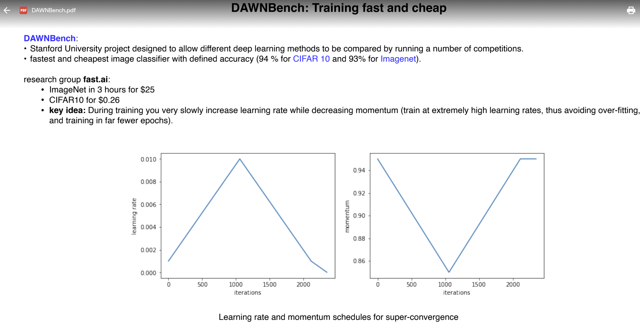

Slide 22
8. BigGAN
Tatyana Nikolayeva

Slide 23
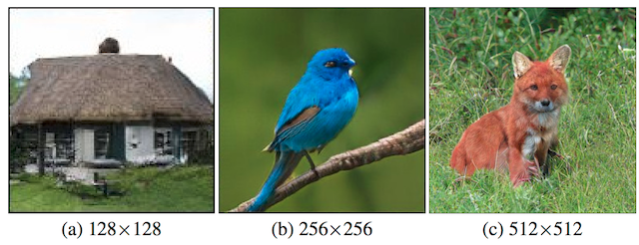
What is new?
the routine generation of both high-resolution (large) and high-quality (high-fidelity) images.
Interpolation
Inception score GAN’s recognition from 50 to over 100

Slide 24
References
Two minute papers
The paper "Large Scale GAN Training for High Fidelity Natural Image Synthesis" is available here:
- Paper: https://arxiv.org/abs/1809.11096
- Try it here https://colab.research.google.com/git...
https://machinelearningmastery.com/a-gentle-introduction-to-the-biggan/

Slide 25
9. Video-to-video synthesis
Malte Sandow

Slide 26
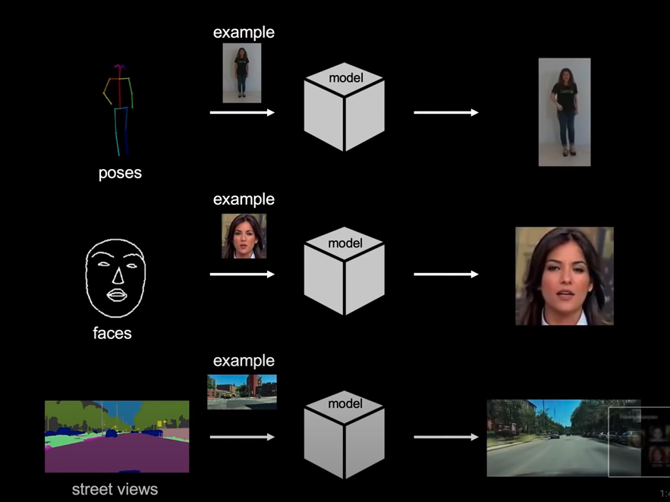
Video to Video Synthesis
From sketch to video
Temporally smooth (not jumpy)
Replace actors / speakers

Slide 27
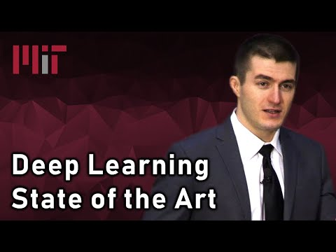

Slide 28
10. Semantic segmentation
Christa Schneider

Slide 29
Semantic segmentation (object detection)
Definition:
Describes the process of associating each pixel of an image with a certain label (mountain, lake, tree, person, car, …)
Goal:
Describes what’s going on in an image
Interaction with human ability
Human error rate = 5.1%
Surpassed in 2015!

Slide 30
Semantic segmentation (object detection
How to use it:
Autonomous driving
Face recognition
…
What’s behind:
Different CNNs with an increasing number of layers (AlexNet 2012 = 8 layers, ResNet 2015 = 152 layers
Region proposal
One-shot method

Slide 31

11. Symmetric Semantic Segmentation
CAS Advanced Machine Learning – Module 2
Christine Sigrist

Slide 32
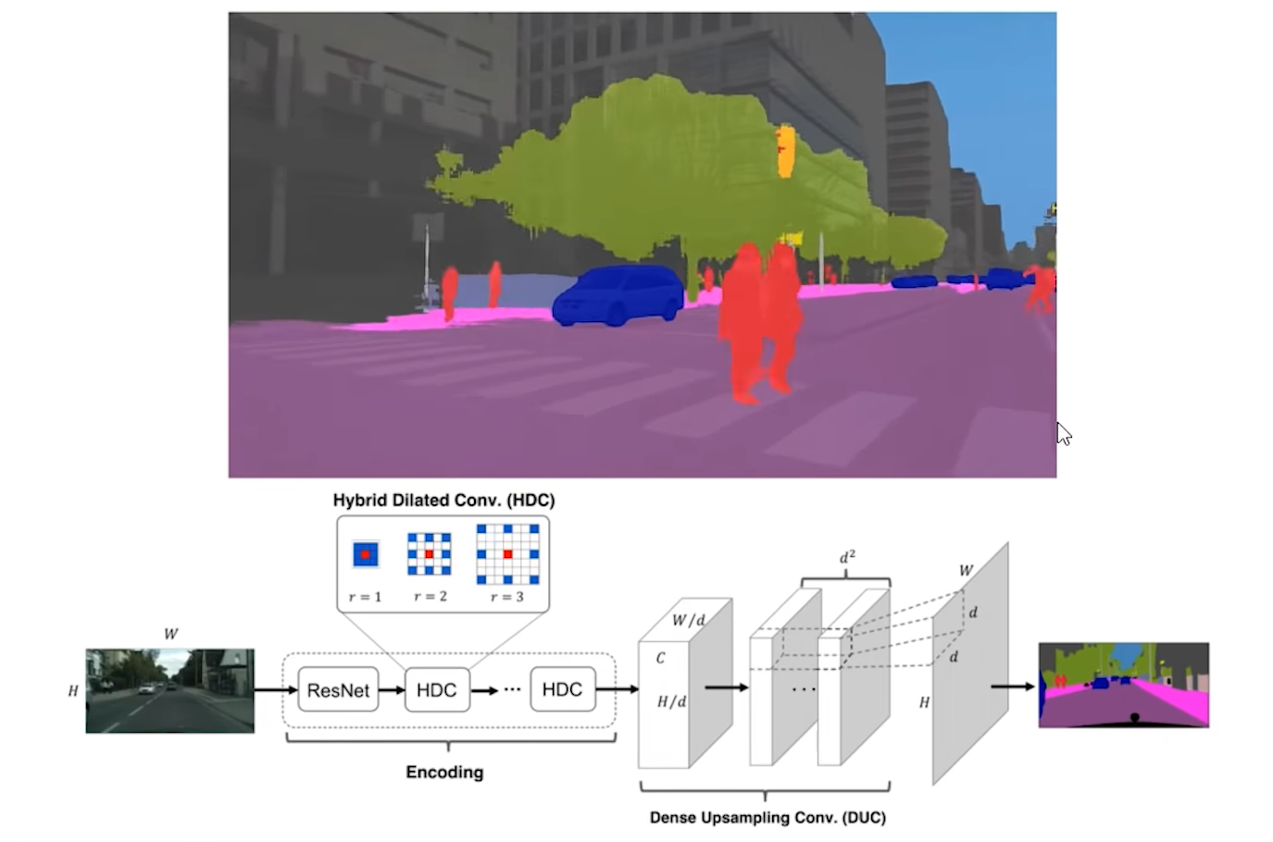
Symmetric Semantic Segmentation
Semantic Segmentation:
Perception problems
Input = Image(s)
Output = high resolution image in which each pixel is classified to a particular class
Highest level of perception, high-level understanding from digital images, videos
Automate tasks that the human visual system can do
Dense prediction: label each pixel of an image with a corresponding class of what is being represented

Slide 33
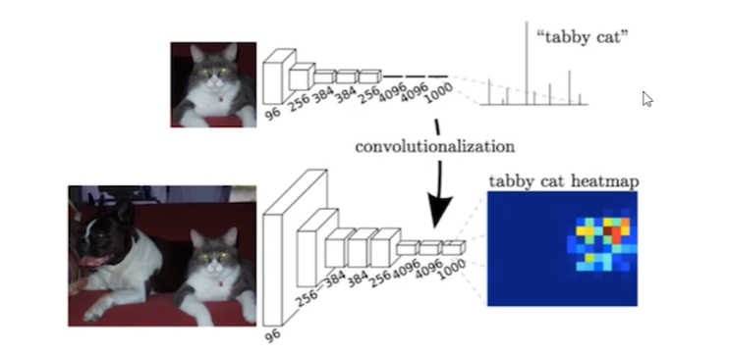
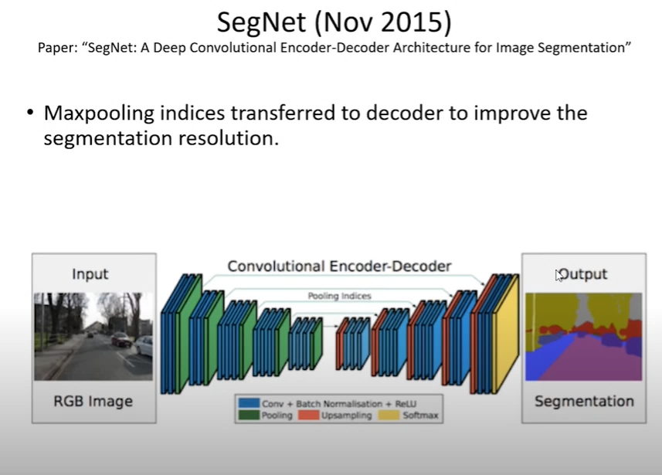
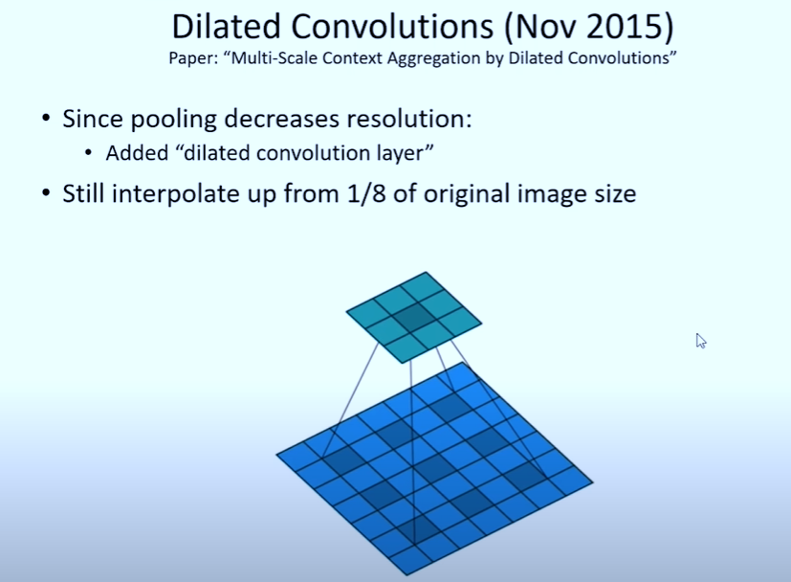
Symmetric Semantic Segmentation
Started in 2014:
Fully Convolutional Neural Networks (FCN) used for Semantic Segmentation
Outputting low resolution heatmaps
Improvements in 2015:
SegNet (= Deep Convolutional Encoder-Decoder Architecture)
Maxpooling indices transferred to the decoder to improve the segmentation resolution
Breakthrough idea: Dilated Convolutions
Pooling decreases resolution – a dilated convolution layer was added
Interpolate up from 1/8 of original image size
SegNet
Dilated
Convolutions

Slide 34
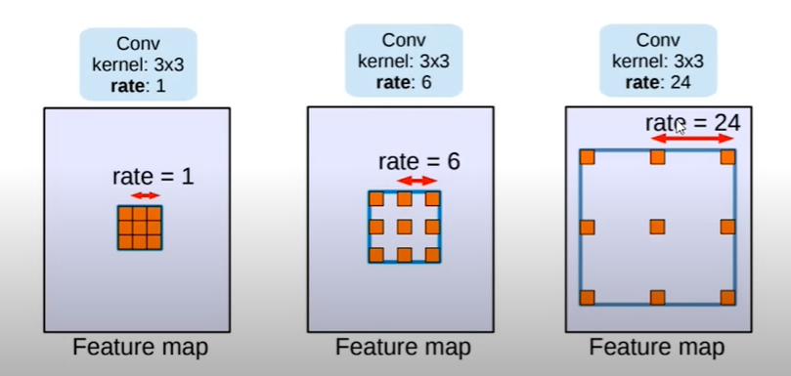
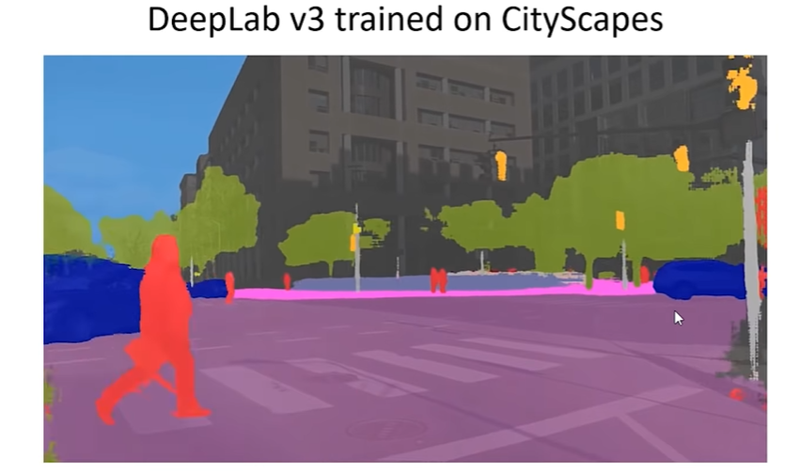
Symmetric Semantic Segmentation
DeepLab v3 (State-of-the-Art)
Produces “state-of-the-art performance”
Key ideas:
Multiscale processing by increasing “atrous rate” (spacing), without increasing parameters
Enlarging the model’s “field-of-view”
Allows to be able to grasp the bigger context
Applied e.g. for driving scene segmentation / autonomous driving systems

Slide 35
12. Google’s AlphaGo
Ivo Vasconcelos

Slide 36
The AlphaGo Approach
Value Networks -> Evaluate board positions
Policy Networks -> Select moves
Combination of Supervised Learning from human expert games and Reinforcement Learning from games of self-play
Monte Carlo Three Search simulate thousands of random games of self-play
Best leaf is selected for self-play games

Slide 37
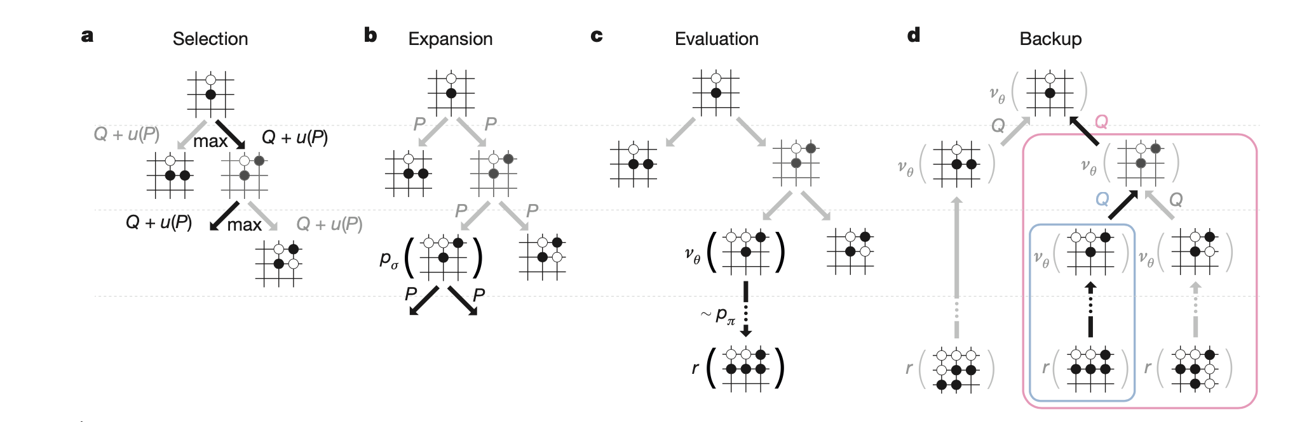

Slide 38
Reference
Deep Learning State of the Art (2019) - MIT. 2019. [video] Boston: Lex Friedman on Youtube.
Silver, D., Huang, A., Maddison, C., Guez, A., Sifre, L., van den Driessche, G., Schrittwieser, J., Antonoglou, I., Panneershelvam, V., Lanctot, M., Dieleman, S., Grewe, D., Nham, J., Kalchbrenner, N., Sutskever, I., Lillicrap, T., Leach, M., Kavukcuoglu, K., Graepel, T. and Hassabis, D., 2016. Mastering the game of Go with deep neural networks and tree search. Nature, 529(7587), pp.484-489.

Slide 39
13. Alpha Zero
Deep Mind Team
Science
Vol 362, Issue 6419 07 December 2018
Tamara VAudroz

Slide 40
Alpha GO Zero (2017)
Beat AlphaGo Lee in 3 days of training
Without any supervision, or any previous knowledge of the game.
Only basic rules as input.
In 40 days it beat every existing version of AlphaGo.

Slide 41
Alpha Zero (2017)
Used 5000 first-generation TPUs to generate the games, and 64 second-generation TPUs to train the Neural Network (all in parallel) with no access to opening books or endgame tables.
The trained algorithm played on a single machine with 4 TPUs.
Alpha Zero beat StockFish in Chess with only 4 hours of training and Elmo in Shogi.

Slide 42
In Chess, there is always a tree of possible future moves. So, the furthest you can look down the tree, the better your moves will be.
StockFish is doing exactly this, billions of calculations…
Human Grand Masters are not playing like that. They can see the patterns in the board. They rely on a kind of intuition/feeling.
Alpha Zero works in this direction, it doesn’t need to make as many calculations. It estimates the quality of the board and moves, and learns the fundamental information.
In this sense, it is more human in its internal workings…

Slide 43
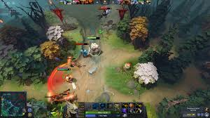
14. OpenAI vs. Humans on Dota 2
Fluri Wieland

Slide 44
Difference to Chess, Go etc
The game is much less structured, its messier, since there are much more possibilities
Not unlike the real world, the player can move around and so does the enemy
Teamwork of players is now of big importance and emphasis on different skilltrees
Uncertainty and hidden information are of importance now

Slide 45
Dota 2 Championships
Winning team gets 11 million dollars
Very active scene with many professional players being fulltime players

Slide 46
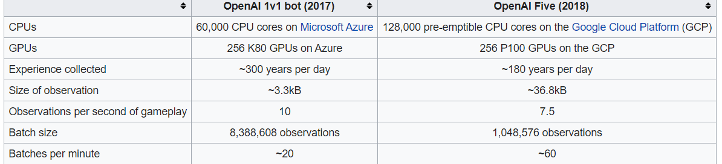
Milestones
2017: 1v1, a OpenAI bot beats the top Dota2 Player in the world
2018: However, OpenAI five lost against the top Dota 2 Players at the international Championship in 5v5, twice
OpenAI five has still not beaten the top players and that being the case, Dota 2 is the current benchmark for AIs

Slide 47
15. Deep Learning Frameworks
Marcel Zeller

Slide 48
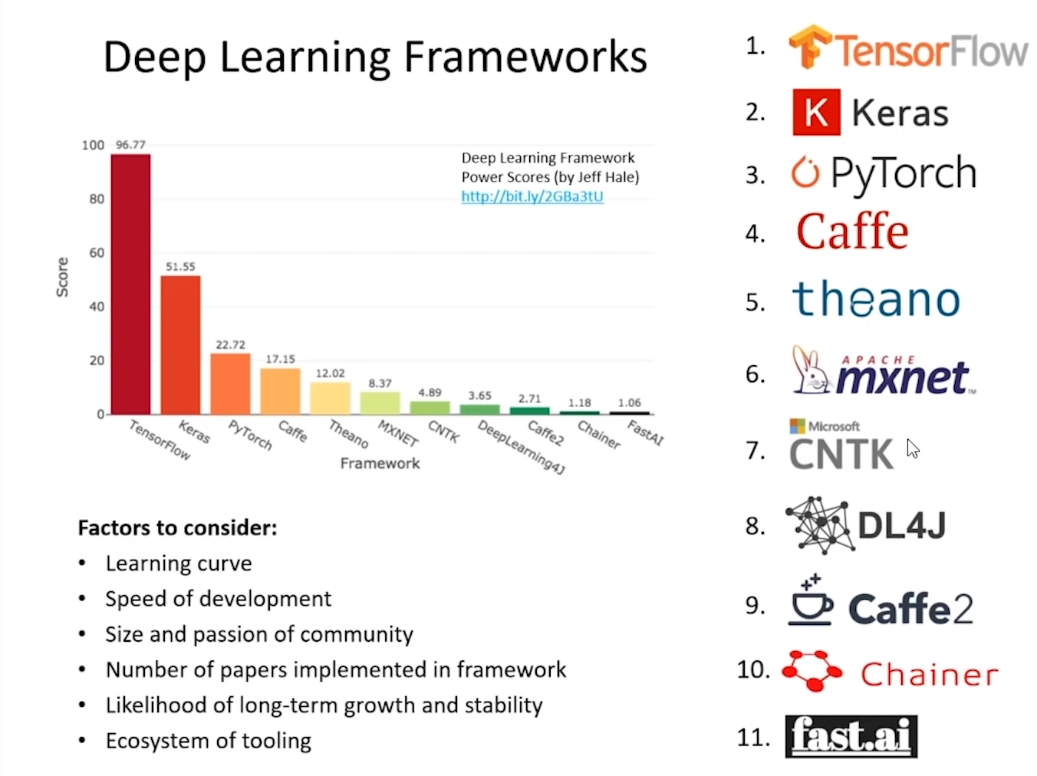
Deep learning frameworks
Marcel Zeller

Slide 49
Deep learning
Deep learning frameworks
Most of them are open-source
Standardization of deep learning
Accessibility and user friendly
Big community, continuous development
Future of deep learning
Ideas based on back propagation and stochastic gradient decent
According to Geoffrey Hinton (Inventor of Deep learning ) new ideas needed!!

